Slide 1
Children’s well-being
Being a parent in an ever changing world!

Slide 2

Times are changing
Mental health, what is it?
You and your child have one- they are different
What is well-being?
Why is it important
Notes:
Frightening statistics
Meantal health taboo- its going.
Wont frighten you with statistics but worrying elements of this are getting younger in our children.
Regardless of COVID we have to try and equip our children with strategies
Give them a tool kit- not stick a plaster- sometimes this feels like the harder choice because we want to fix it for them.
Think about yourself- its only when you go through something you learn and it shapes you
Preparation not denial
You have a mental health- its as significant as your physical health.
All about Well being
Emotionally stable, know that pressures will hit you but give skills to cope
Airplane model overused- sort your own oxygen mask before others- I’ve always struggled with this analogy- but the essence of what it is saying is look after yourself keep check of yourself as well as your children because when you are running alongside them in that marathon you will run out of steam and then you wont help.

Slide 3

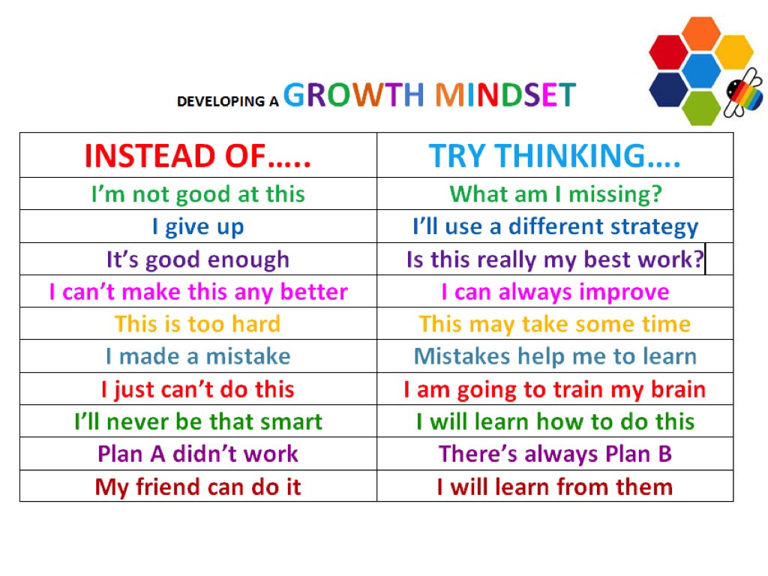
Mindset
Starts with mindset
Notes:
So where can we start- for the sake of today 2 small strategies
Mindset- simple part of changing your childrens mindset (and yours)
These simple strategies help them look at challenges in a different way. Stops us feeling we cant do it-
This comes from school work to when they are feeling these emotions too
Perseverance – keep going resilience – our kids are SOOOO resilient
Staff as well- so as parents- set ourselves changes FAMILY
5k- staff
Children- ride bike without stabilizers etc

Slide 4
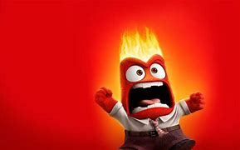
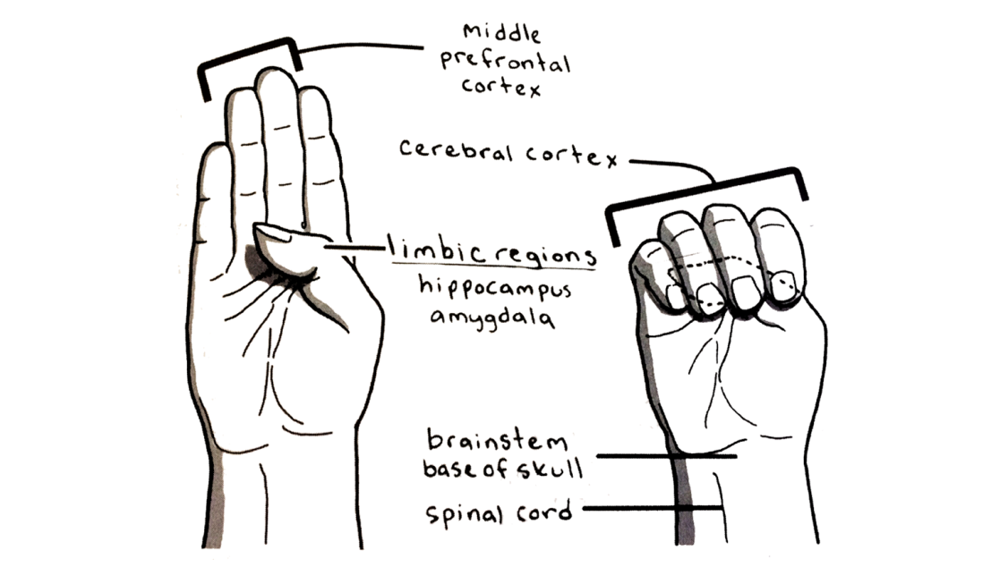

Flipping my lid
Notes:
2. This is when all the other stratgeies have gone and our kids have exploded.
Its called flipping their lid- we teach children from 4 and show them- flight fright = thumb
So parents the truth is they are not in ontrol of what they are doing- choices hae gone, the nerves cant reach those parts of the brain- thjis looks dffierent in 5 year old that 15 but the principle is the same.
Inside out box- flip lid anger sadness- negative but not EC
This happens to us too- me and my youndest have a new way of dealing with this we show each other where we are at. And sometimes the best thing I can do is walk away, thien come back to it.

Slide 5
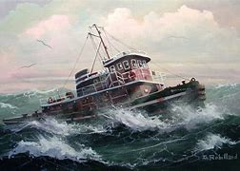
Look how far you have come…
COVID
We are all in the same storm- different boats
Resilience
Communities pulling together
Managing change

Slide 6
Some tips that work for me (sometimes)
Maybe create your own inside out box-
Spend some time colouring with your child- colour therapy is amazing
Ask them 3 stars and a wish- 3 good things about the day and 1 to improve
Its all in their time not ours-
Stay away from social media if its not uplifting you
Walk away and take a breath- OUTDOOORS
Parent wellbeing CALM app Mindfulness app- others suggested
Next; Emotion coaching- would you be interested?
Notes:
Maybe create your own inside out box- INSIDE OUT FILM
Spend some time colouring with your child- colour therapy is amazing
Ask them 3 stars and a wish- 3 good things about the day and 1 to improve
- Boys walk home
Its all in their time not ours-
Walk away and take a breath-
CALM app Mindfulness app- others suggested
Signpost- if need more support
NEXT WEEK- EMOTION COACHING!!!!!

