Slide 1
Emotion coaching

Slide 2

What is mental health
Give them a tool kit- not stick a plaster on
Notes:
Becky

Slide 3
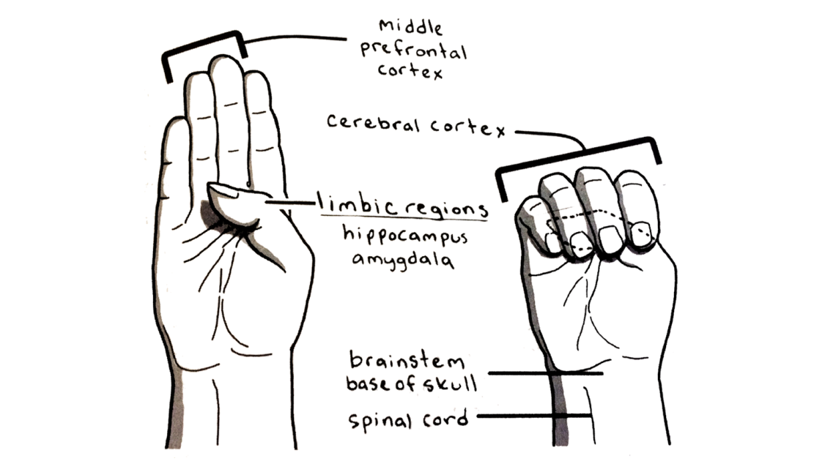
Flipping the lid

Slide 4
Why emotion coach
Emotion coaching gives strategies to deal with ups and downs in school and in life.
Use moments of negative behaviour as opportunities for teaching.
Builds trusting and respectful relationships
Accepts that negative emotions are normal
Inside Out - Emotional Intelligence - Bing video

Slide 5
Emotion caching recap
  Promotes positive relationships between adults and children through promoting trust.
  We become more sensitive to children’s needs showing and promoting “empathy”
  Reduces behaviour incidents & exclusions
  We feel more ‘in control’ during incidents
  Demonstrates consistency.
  We lead by example.
  We can support parents so emotion coaching can be used at home.
  Supports mental health and well being of all children and adults.
Notes:
Deb/Marg- we can change these slides to the bits you’ve already done- I just had this from a course I did- this slide looked at the difference between anger and sadness and that we have more empathy for the sadness not the anger and why that might be-

Slide 6
Emotion Coaching should be used 60% of the time.
It might not work in every situation but give it a go.

Slide 7
Emotion Coaching Steps.
Step 1
Recognise the child’s feelings
Step 2
Label and help the child understand the feeling. Validate.
Step 4
Problem solve with the child (what strategies would work to help regulate emotions)
Step 3
Set limits on behavior (how, when, where to express and display feelings)

Slide 8
Steps to emotion coaching and script
Step 1 - Recognising the child’s feeling
Adult – “I can see that you have your head down, you’re biting your jumper and you’re clenching your hands, I feel you might be feeling angry?” (Name to tame emotion, show understanding and empathy.)
Step 2 - Label and help the child understand the feeling, Validate.
Child – “I feel angry.” Or they will label another emotion.
Adult – do you know why you feel angry? Can you remember what happened before you started feeling angry? What made you feel like this?
Adult – “that could make me feel angry too (showing understanding)
This might be an opportunity to visit inside out basket to self-regulate.
Step 3 – Set limits of behaviour (How, when and where to express and display feelings)
Adult – “It’s ok to feel angry but it’s not ok to throw things around but throwing eg chairs and pencils could hurt you or someone else.” Opportunity for child to tidy up equipment they have thrown.
Step 4 – Problem solve with child (what strategies would work to help regulate emotions)
Adult – what could you do next time you feel your lid starting to flip? Do they recognise triggers, what do they prefer to do to self regulate?
A child may not be ready to emotion coach if their lid is still flipped, wait until they are ready to communicate with you.
Notes:
Michelle P- I didn’t know if we could reflect here on the Roman Kemp Documentary- not our bit but the ask twice mentality that its tryng to promote and the buddy support which is so important in upper KS2- I can write some more bits here if you think its appropriate

Slide 9
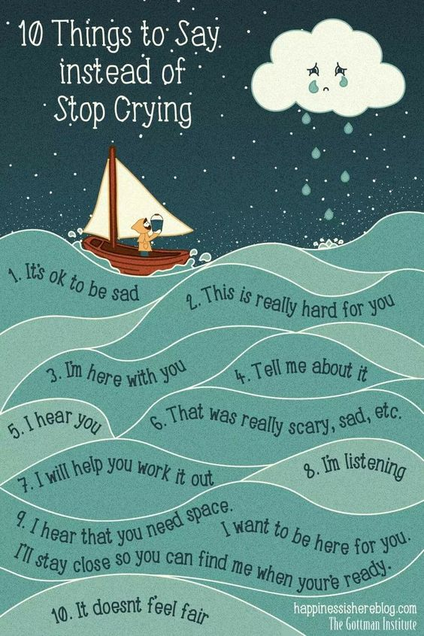

Slide 10
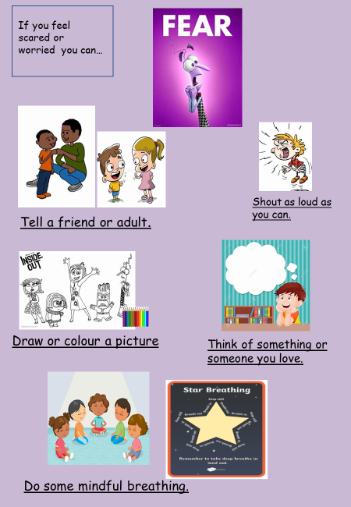
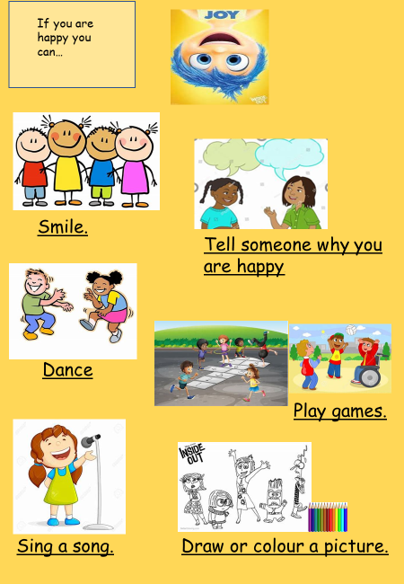
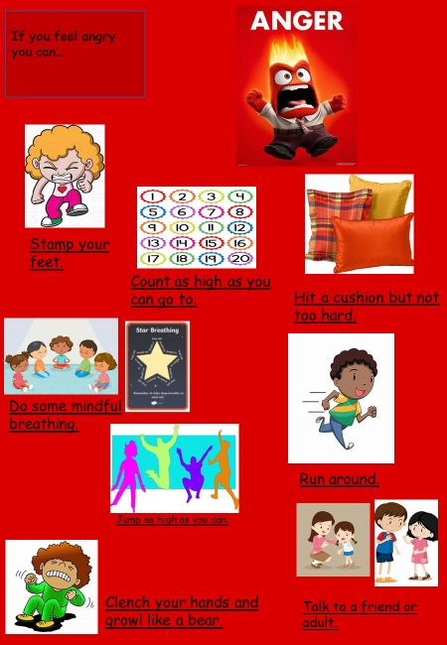
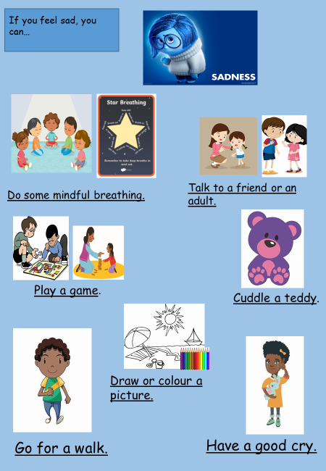
To help us bring our lid down and regulate our emotions, we could…
Children can use the inside basket in the classroom and the regulation station (calm corner) on play ground
When you feel these emotions, what do you do to bring your lid down? TTYP

Slide 11
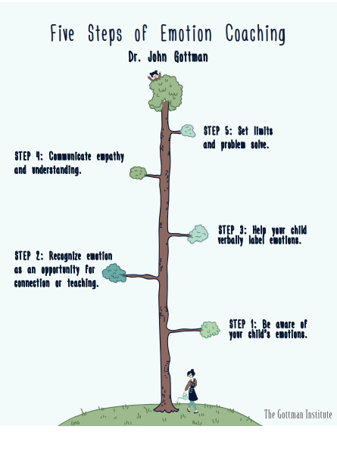

Slide 12
Discussion time
Behaviour Policy- relational

Slide 13
Thank you
Thoughts for Emotion Coaching going forward

